Slide 1

Yelp Review Context Classifier
Team 47
Paul Moreno
Ilean Monterrubio Jr

Slide 2

Vertical Search Engine
Popular
Domain Specific
Uses implicit data about the User
Mobile devices, location
User can rank results in terms of different parameters

Slide 3
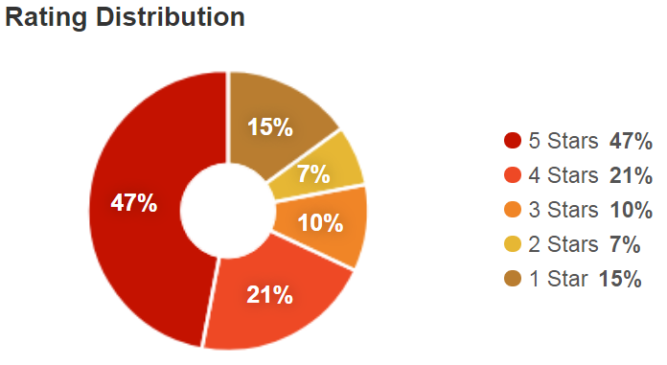
Yelp
Review
Anyone can review a business
Multiple Business types on yelp
Rating
5 to 1 stars

Slide 4
Current Yelp Tools
Focus on consumer side
Grubhub
Postmates
And many more….
Business
Advertising, Promotions, and Gaining Exposure
Reservations for Customers
Respond to Reviews
Analytics

Slide 5
Yelp Analytics
Customer Leads
Search Query Hits
Page Visits
Traffic to Website
Map to Business
Called Business
Yelp doesn’t help track Reviews

Slide 6
Tool Envisioned
Targets business
Performance Tracking
Identify Events that have influenced Star Rating
Classify Reviews into two 2 categories

Slide 7
Data
Yelp Open Dataset
JSON vs SQL
JSON to CSV
CSV header
business_id, date, review_id, stars,text, type, user_id, cool, useful, funny
Review Classification:
Goods, i.e. food, coffee, clothing
Service, i.e. restaurant, dry cleaners, movie theaters
Sentiment Analysis

Slide 8
Tool Description
Command line tool
It broken up in 2 parts
yelp_clean.py
Cleans and extracts the word distribution for the classifier training data set
yelp_classify.py
Classifies the reviews entered by the user
The sample provided classifies 400 reviews
For a collection of reviews to be entered
User would change fname variable in each file
Comment the evaluation section of the code

Slide 9
Installation of Tool
Linux
Download tool:
https://github.com/ileanmjr88/CS410-Project
Either clone using git or download as zip file.
Install using terminal:
$ cd (user directory)/CS410-Project
$ sudo pip install –e . (period required)
$ python download_nltk.py

Slide 10
Use Tool
Open Terminal
Navigate to directory
$ cd (user directory)/CS410-Project
$ python yelp_clean.py
Terminal output:
yelp_clean.py::starting
yelp_clean.py::complete

Slide 11
Use Tool Cont’
Once yelp_clean.py complete
Terminal command:
$ python yelp_classify.py
Terminal output:
yelp_classify.py::starting
(Metrics of both classifiers used, output)
yelp_classify.py ::completed

Slide 12
Outputs
Inside directory they are 2 graphs
Naivebayes.png
LinearSVC.png
These graphs are bar graphs
They graph Service in Red and Goods in Blue
Star rating vs number of comment
This graph will help the business if they are excelling in one category on a star rating level

Slide 13
Example
Tool preloaded demo
$ python yelp_clean.py
Terminal output:
yelp_clean.py::starting
yelp_clean.py::complete

Slide 14
Example Cont’
Tool preloaded demo
$ python yelp_classify.py
Terminal output:
yelp_classify.py::starting
Context Classification:
('Naive Bayes Classifier accuracy: ', 0.68)
('Precision of goods:', 0.3625)
('Recall of goods:', 0.7467811158798283)
('Fmeasure of goods:', 0.4880785413744741)
('Precision of service:', 0.33059548254620125)
('Recall of service:', 0.7666666666666667)
('Fmeasure of service:', 0.4619799139167862)
('LinearSVC Classifier accuracy:', 0.6571428571428571)
('Precision of goods:', 0.33689024390243905)
('Recall of goods:', 0.9484978540772532)
('Fmeasure of goods:', 0.4971878515185602)
('Precision of service:', 0.30579964850615116)
('Recall of service:', 0.8285714285714286)
('Fmeasure of service:', 0.4467265725288832)

Slide 15
Example Cont’
Tool preloaded demo
Terminal output:
Sentiment Analysis:
('Naive Bayes Classifier accuracy: ', 0.662)
('Precision of pos:', 0.8091397849462365)
('Recall of pos:', 0.8918518518518519)
('Fmeasure of pos:', 0.8484848484848485)
('Precision of neu:', 0.6320754716981132)
('Recall of neu:', 0.4557823129251701)
('Fmeasure of neu:', 0.5296442687747036)
('Precision of neg:', 0.7)
('Recall of neg:', 0.5898876404494382)
('Fmeasure of neg:', 0.6402439024390244)
('LinearSVC Classifier accuracy:', 0.664)
('Precision of pos:', 0.8121059268600253)
('Recall of pos:', 0.9540740740740741)
('Fmeasure of pos:', 0.8773841961852861)
('Precision of neu:', 0.5859872611464968)
('Recall of neu:', 0.6258503401360545)
('Fmeasure of neu:', 0.6052631578947368)
('Precision of neg:', 0.6388888888888888)
('Recall of neg:', 0.7752808988764045)
('Fmeasure of neg:', 0.700507614213198)
yelp_classify.py::completed

Slide 16
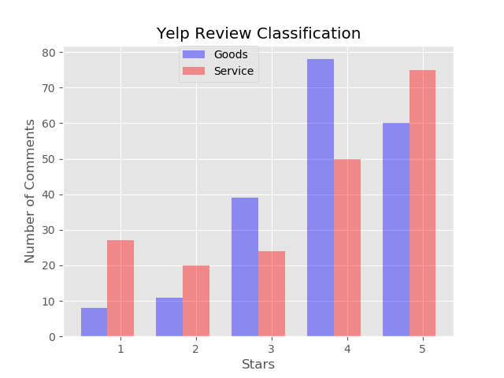
Naïve Bayes Graph Output

Slide 17
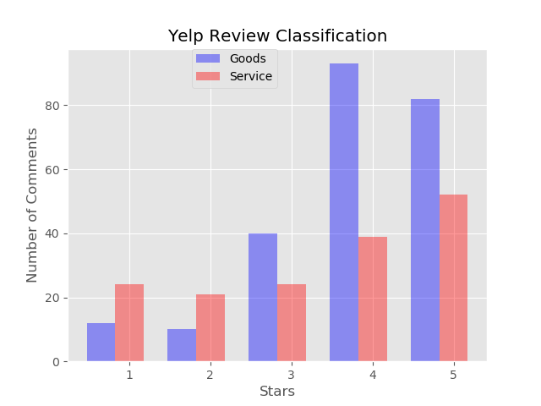
LinearSVC Graph Output

Slide 18
Future Work/ Improvements
Include more categories to allow for complex context representation of reviews
Track ratings with respect to time
Compare Text Data produced and the previous time period
Mine Causal topics with Time Series Supervision
Allows you to understand any important events that have effected the business ratings

Slide 19
Thank You

